Slide 1
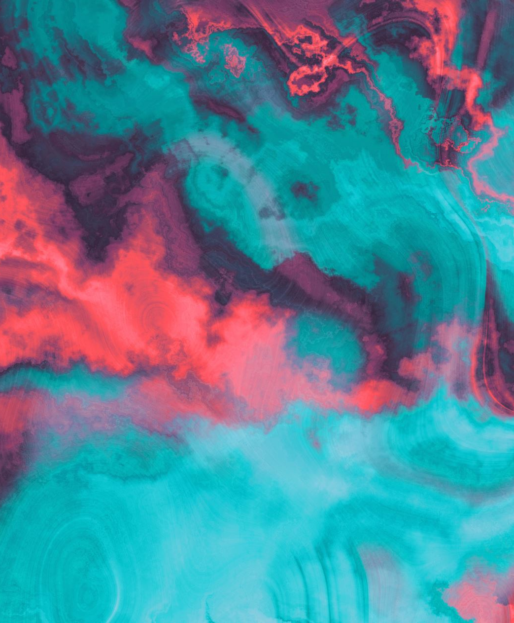
Mini Research Project
Grad CAM for CNN Interpretability
Carlos Mendez
MSCS 2201

Slide 2
Tl;dr: mOTIVATION, MAIN IDEA, AND RESULTS
Deep CNNs are highly accurate but operate as black boxes (we cannot how they are determining their choice).
Grad-CAM generates heatmaps showing which image regions influence the model’s decision.
Results: The model focuses correctly on meaningful features (dog face, car doors), and exposes failure cases where it attends to irrelevant areas.

Slide 3
Table of contents
Motivation
01
Literature Review
02
Method / Approach
03
Demonstration (YouTube)
04
Results (Dog, Personal Dog, Car, Failure Case)
05
Discussion & Limitations
06
Conclusion
07

Slide 4
Motivation
Neural networks perform extremely well but lack transparency.
Interpretability increases trust, safety, and debuggability.
For vision tasks, visual explanations like heatmaps are the most intuitive.
Grad-CAM allows us to “look inside” a CNN without changing its architecture.

Slide 5

Literature Review (Part 1)
Key interpretability methods:
  LIME (2016): Creates local surrogate models to explain individual predictions.
  SHAP (2017): Uses Shapley values to measure feature importance.
  Grad-CAM (2017): Uses gradients + activations to produce class-specific heatmaps for CNNs.

Slide 6
Literature Review (Part 2)
Interpretability vs Explainability (Lecture 9):
  Interpretability: Understanding input-output behavior.
  Explainability: Producing human-like reasoning after the fact.
  Grad-CAM is a post-hoc explainability technique; it explains the model’s behavior without modifying the model.

Slide 7
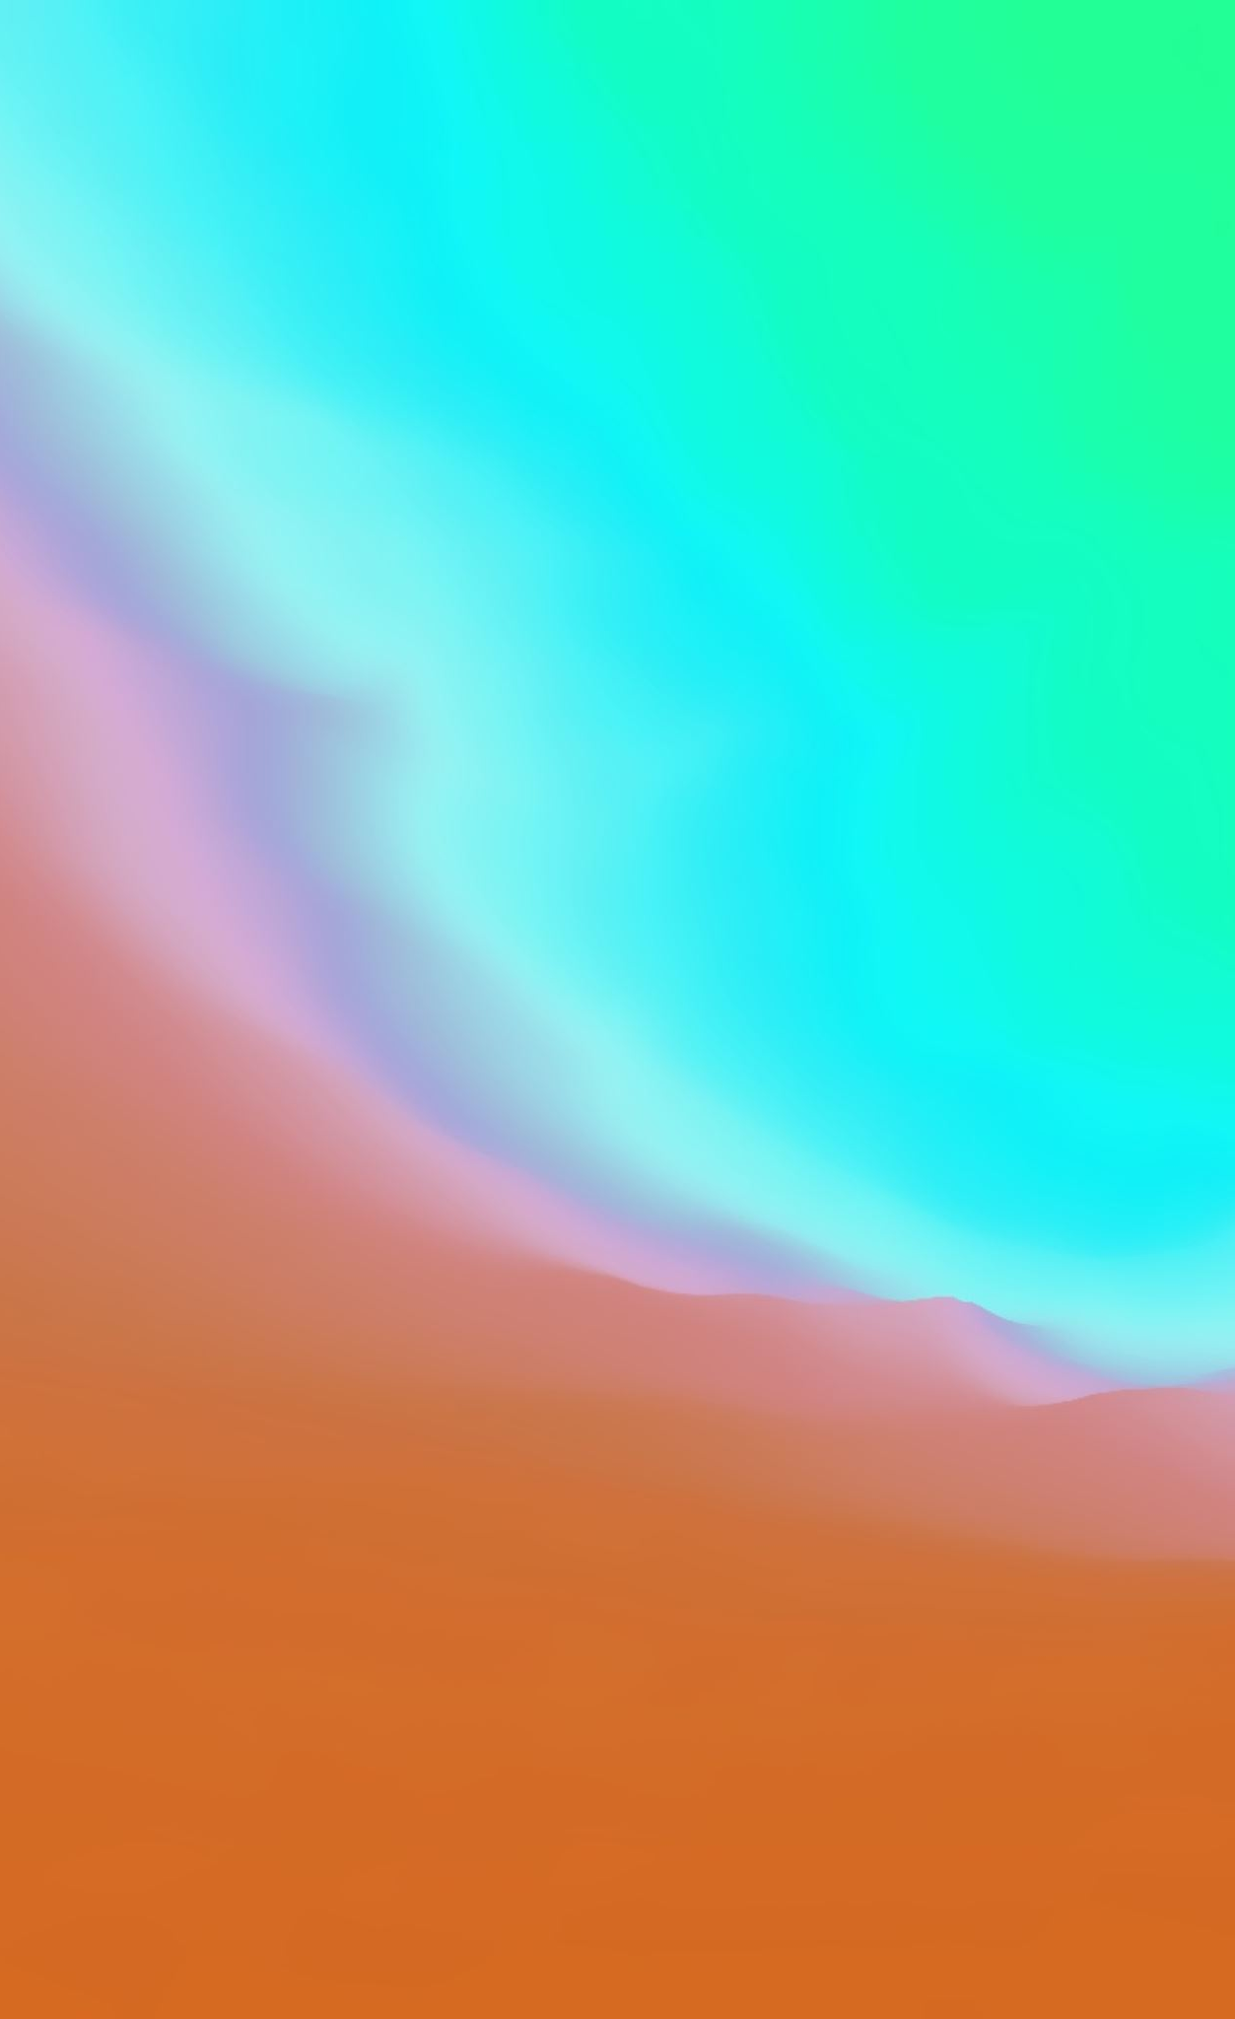
Approach / Method Used
Pretrained ResNet50 (ImageNet) used as the model.
Capture activations and gradients from the final convolutional layer (layer4).
Combine gradients with activations to compute a weighted heatmap.
Resize and overlay heatmap on top of original image.
Implemented end-to-end in Google Colab using PyTorch.

Slide 8
Implementation Overview
Load and preprocess an input image (your dog, a car, etc.).
Forward pass → get class prediction + feature maps.
Backward pass → compute gradients for target class.
Generate heatmap based on gradient weights.
Visualize: original, heatmap, overlay.
Notes:
Add Code screenshot here

Slide 9
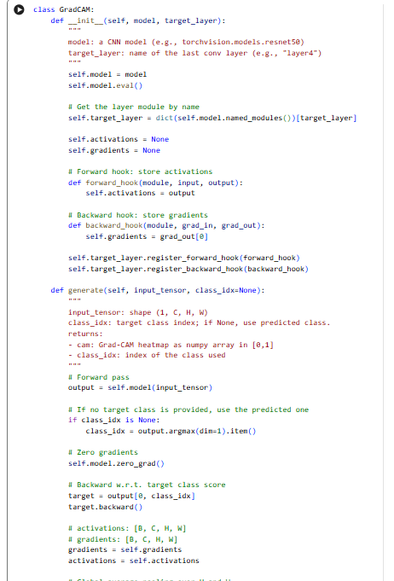
Implementation Overview
Defines the Grad-CAM class, which captures activations and gradients from the last convolution layer.
Combines these to create a heatmap showing what parts of the image the model used for its prediction.
Loads a pretrained ResNet50 model and attaches Grad-CAM to its final conv block (layer4).
This allows us to generate clear visual explanations of the model’s decisions
Notes:
Add Code screenshot here

Slide 10
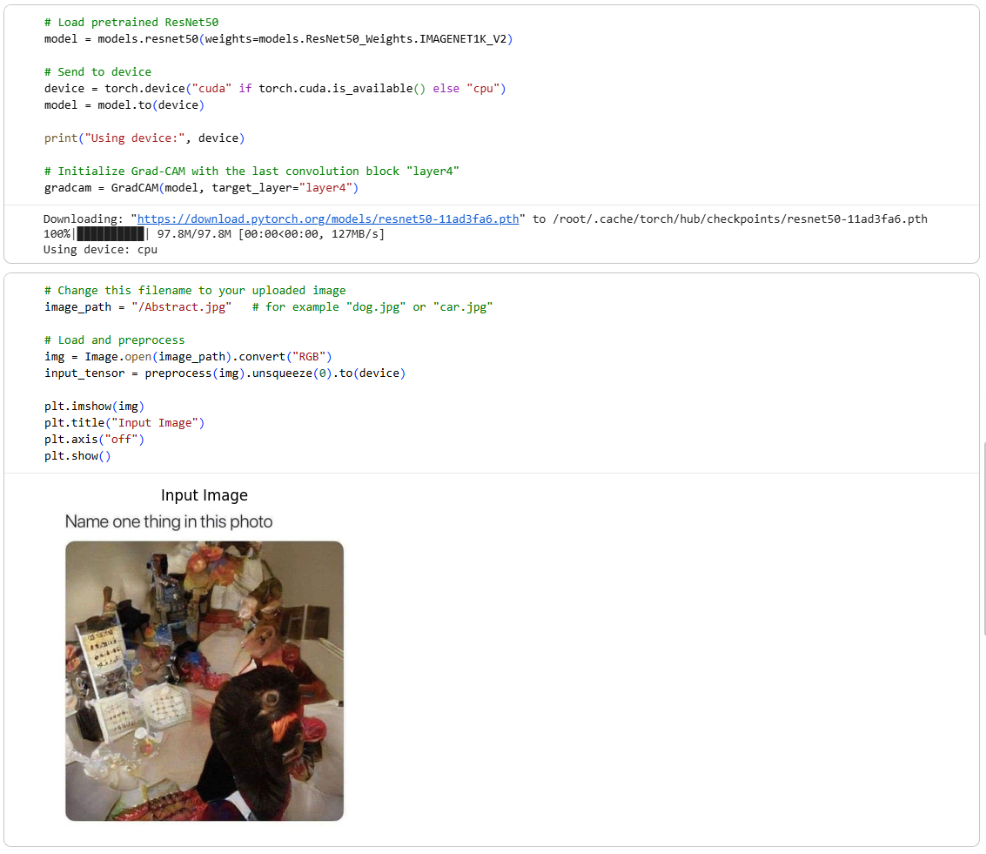
Implementation Overview
Loads an image (dog, personal photo, car, or ambiguous image) and preprocesses it so ResNet50 can read it.
Converts the image to a tensor, normalizes it, and sends it to the model’s device.
Runs the image through the model and uses Grad-CAM to compute a class-specific heatmap.
Identifies the predicted class and returns the raw Grad-CAM map for visualization in the next step.
Notes:
Add Code screenshot here

Slide 11
Demo (YouTube Link)
https://youtu.be/bLNHfx-hbgU
Notes:
Describe content briefly:
Running the Grad-CAM notebook
Showing heatmaps for different images
Explaining what the model focused on

Slide 12
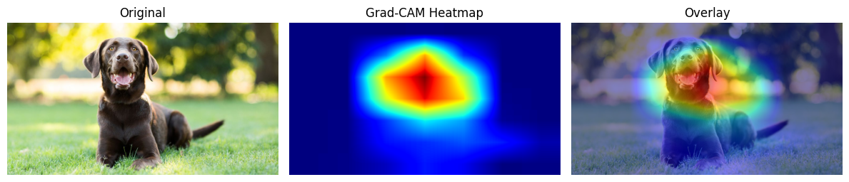
results: google Dog Image
The heatmap highlights the dog’s face, especially the eyes and snout.
Model attends to the most discriminative regions for dog classification.
This is a successful explanation: behavior matches human intuition.
Notes:
Add stock dog photo image and the heatmap and overlay

Slide 13
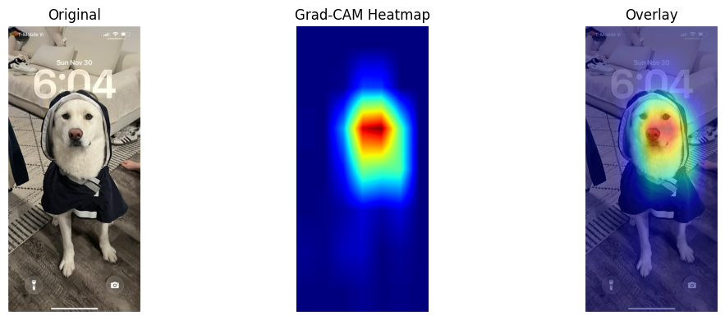
Results: My Dog (Personal Photo)
The model still focuses on the face and upper body even though this is not an ImageNet training image.
Shows good generalization to personal photos.
Some background activation may appear depending on lighting or pose. (For example, the side of the rain cap)
Notes:
Insert Copo's image here and its Grad CAM Overlay.
Explain how there are other items that could possibly throw off the image (couch, showes, foot, numbers and letters). However the CNN is able to make a determination correctly and it shows that it is using the correct area.

Slide 14
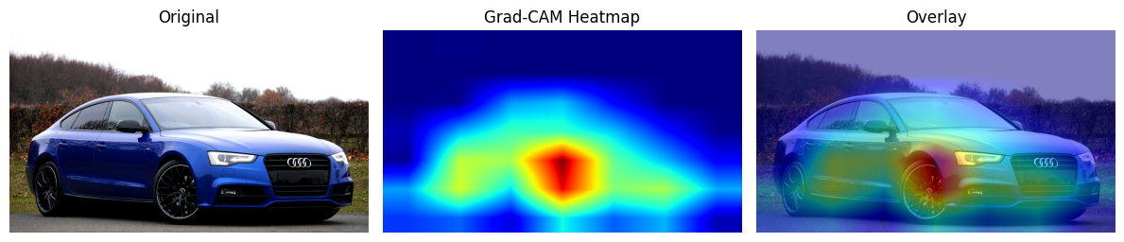
Results: Car Image
Heatmap activation clusters around wheels, headlights, and body edges.
CNN focuses on structural features that help classify vehicles.
This aligns with how humans identify cars, another strong, meaningful explanation.
Notes:
Insert Car test image

Slide 15
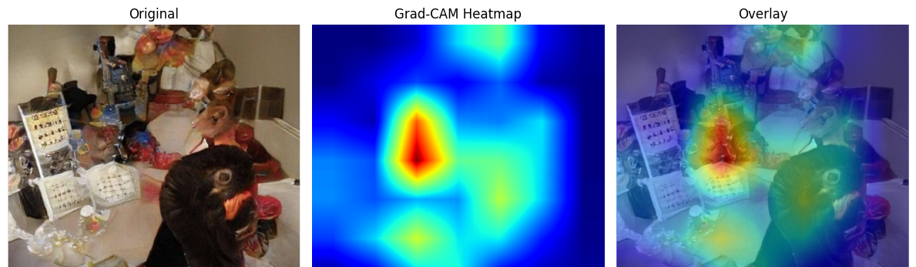
Results: ambigious image / Failure case
The model’s attention is inconsistent or misplaced; heatmap may focus on background, shadows, or random textures.
This indicates model uncertainty and lack of discriminative features.
Great example of Grad-CAM exposing when a model is “guessing.”
Notes:
Insert Ambigous image and overlay.

Slide 16
Discussion & Limitations
Grad-CAM is post-hoc, so explanations approximate, not perfect.
Sensitive to choice of convolutional layer.
Heatmaps sometimes highlight irrelevant regions.
Not suitable for non-CNN architectures unless adapted
Does not guarantee “true” model reasoning, but gives useful insights.

Slide 17
Conclusion
Grad-CAM is a simple, powerful tool for CNN interpretability.
Visual heatmaps help validate correct behavior and detect failure cases.
Works well for everyday images, including custom photos.
Future work: Grad-CAM++, Vision Transformer explanations, Integrated Gradients.

Slide 18
References
Selvaraju, R. R., Cogswell, M., Das, A., Vedantam, R., Parikh, D., & Batra, D. (2017). Grad-CAM: Visual explanations from deep networks via gradient-based localization. ICCV, 618–626. https://doi.org/10.1109/ICCV.2017.74
Ribeiro, M. T., Singh, S., & Guestrin, C. (2016). “Why should I trust you?” Explaining the predictions of any classifier. KDD, 1135–1144. https://doi.org/10.1145/2939672.2939778
Lundberg, S. M., & Lee, S.-I. (2017). A unified approach to interpreting model predictions. NeurIPS 30.
He, K., Zhang, X., Ren, S., & Sun, J. (2016). Deep residual learning for image recognition. CVPR, 770–778. https://doi.org/10.1109/CVPR.2016.90
Paszke, A., Gross, S., Massa, F., et al. (2019). PyTorch: An imperative style, high-performance deep learning library. NeurIPS 32. https://pytorch.org
Guidotti, R., Monreale, A., Ruggieri, S., Turini, F., Giannotti, F., & Pedreschi, D. (2018). A survey of methods for explaining black box models. ACM Computing Surveys, 51(5), 93.
He, K., Zhang, X., Ren, S., & Sun, J. (2016). Deep residual learning for image recognition. CVPR, 770–778. https://doi.org/10.1109/CVPR.2016.90
Sofia University. (2024). Lecture 9: Interpretability & Explainability. MSCS 2201 – Artificial Intelligence.

